Slide 1
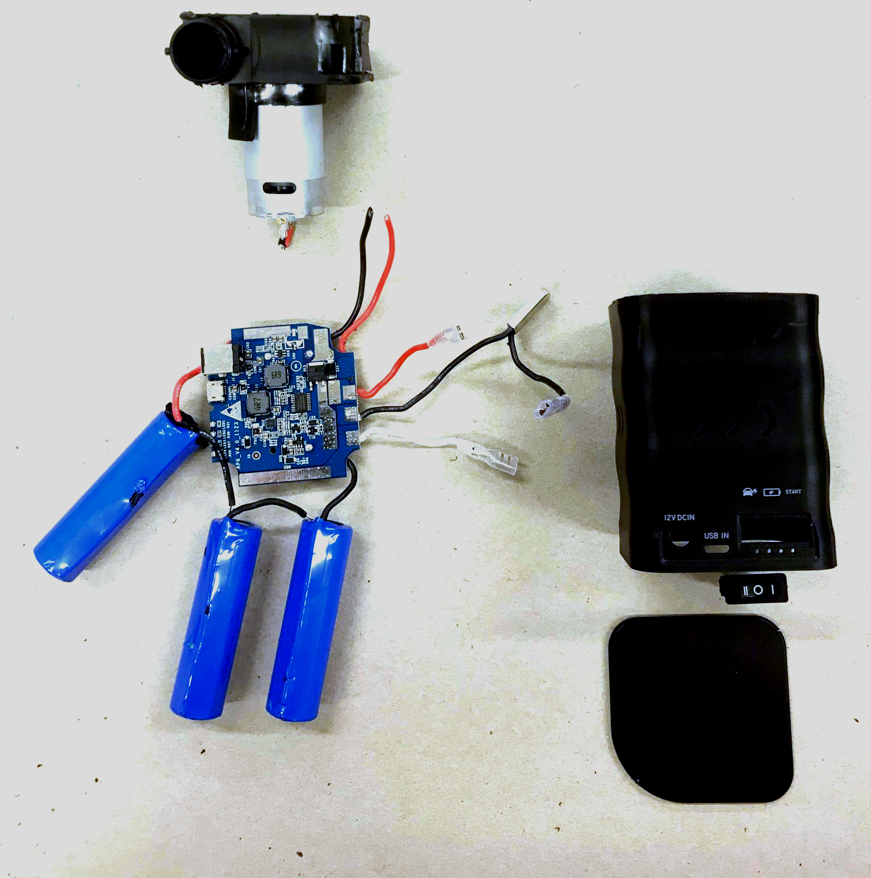
START OF TECHNICAL SLIDES

Slide 2
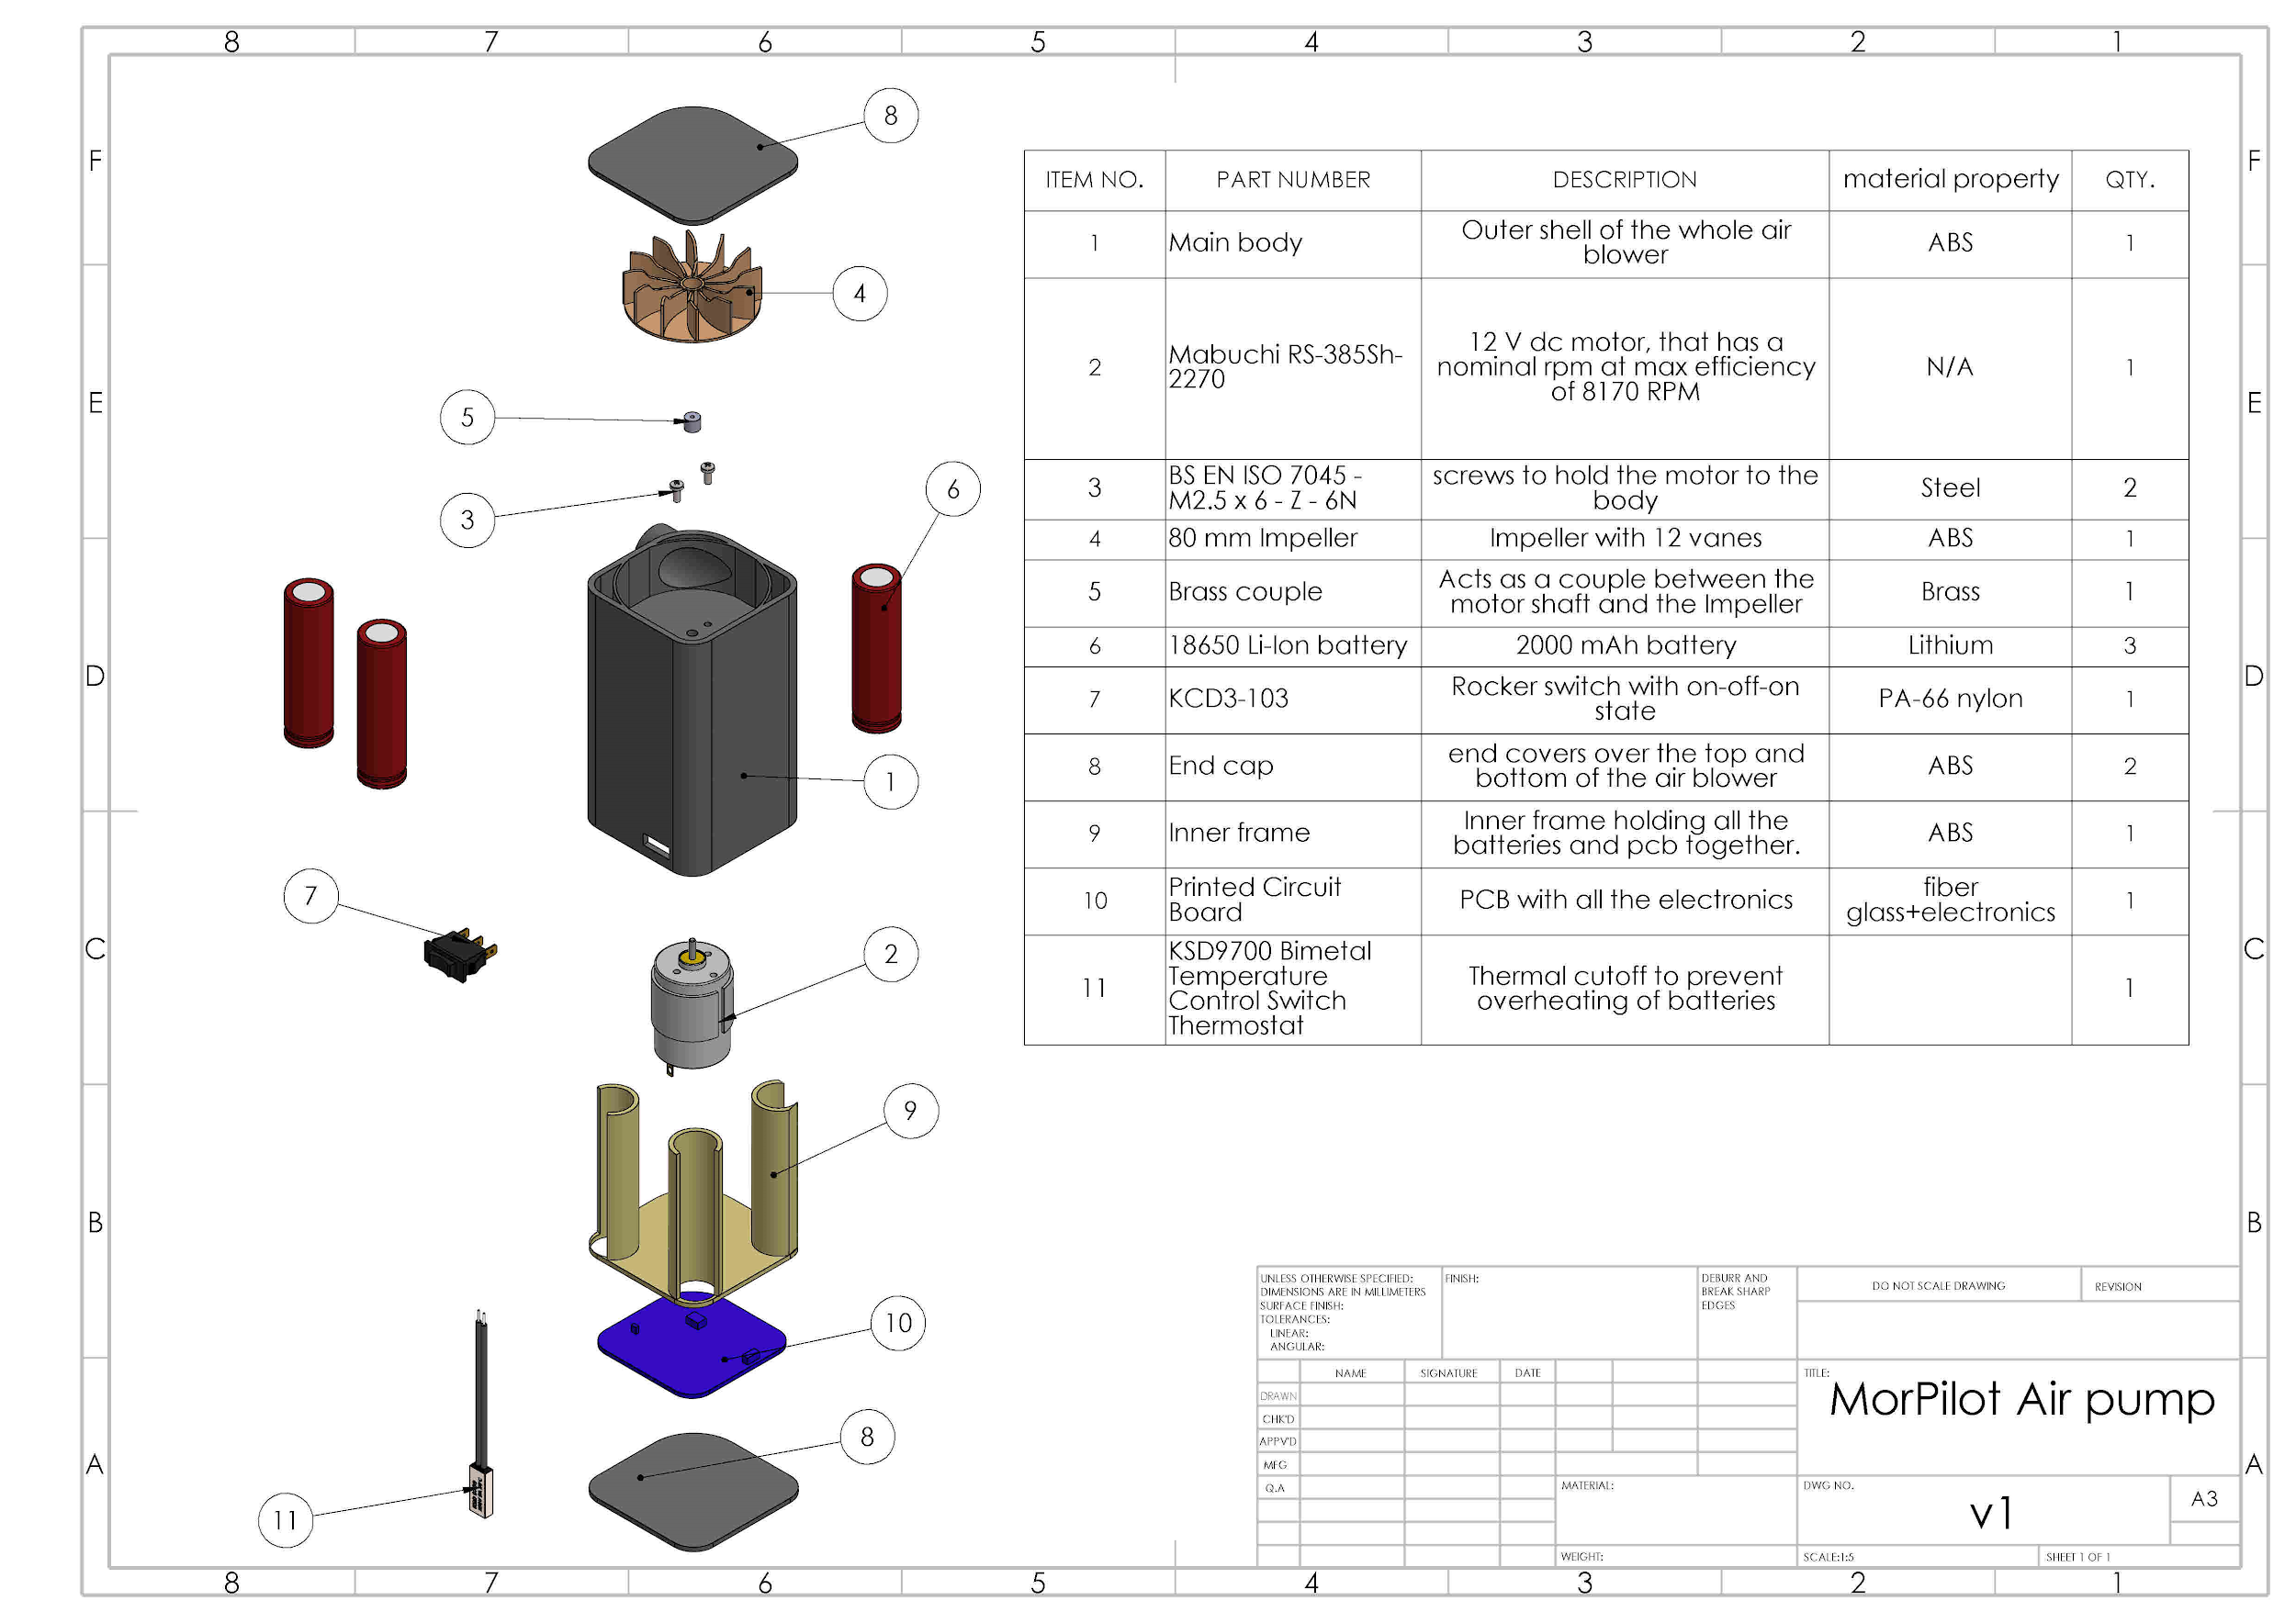
Bill of materials and blown up view
This is a breakdown of all the components in the MorPilot air pump. A bill of Materials is included here as well.
NOTE that this blown up image is in the drive separately.
Notes:
Current state as of 10:11pm
TODO: change the view to something better, change the part numbers and add better descriptions

Slide 3
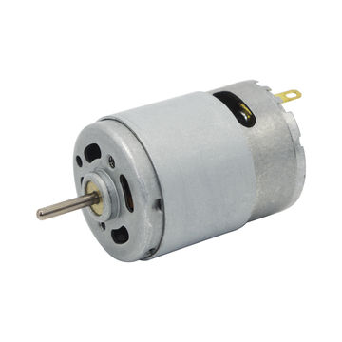
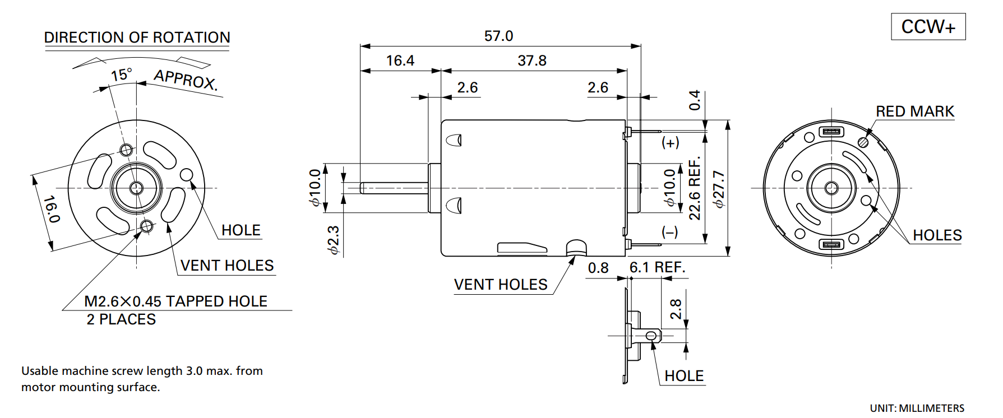
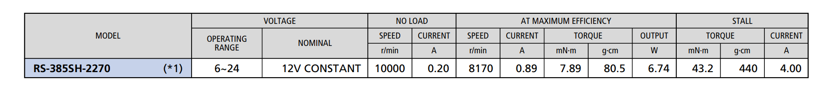
Mabuchi RS-385 DC motor Specification
Interesting things about the motor:
- High rpm for a fan
-Typical applications:
- Hair Dryer
- Printer/Copy machine
- Ideal to make an air blower or compressor

Slide 4
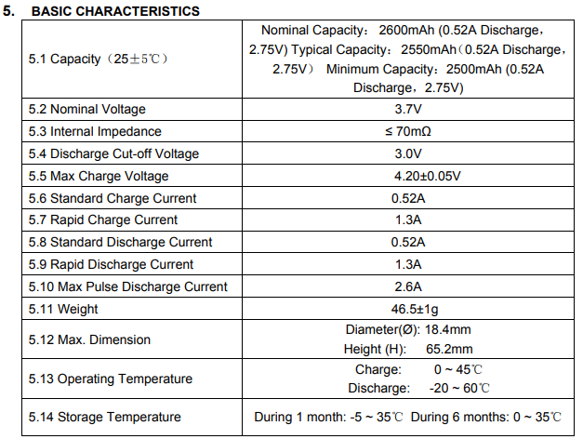
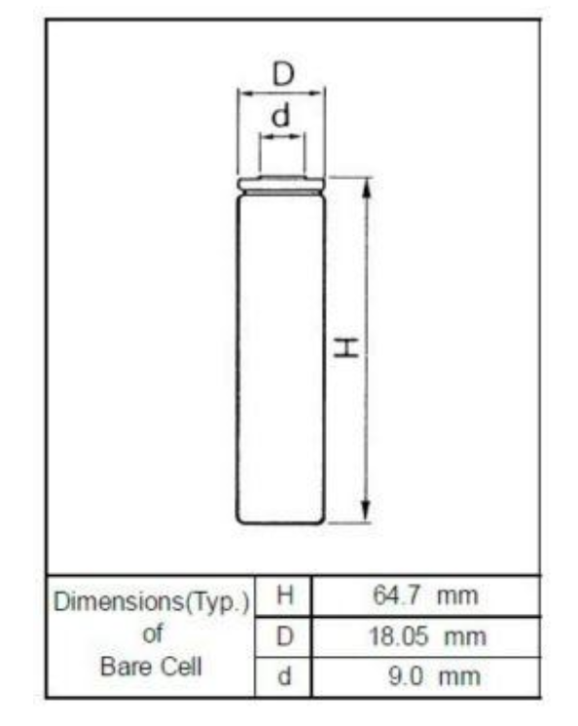
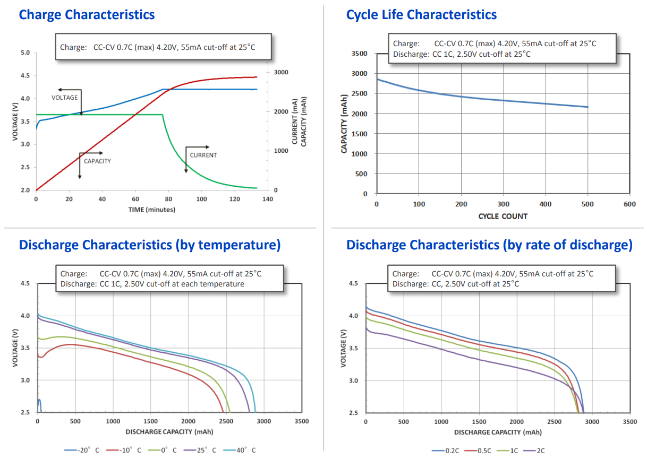
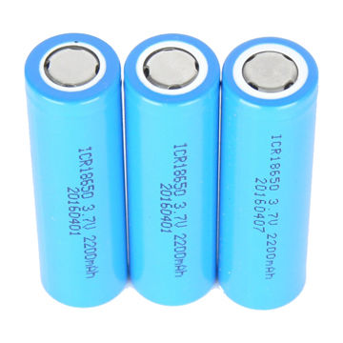
18650 Battery Specification
The interesting thing is:
-LITHIUM ION battery
High power output
-Rechargeable
-High energy density
-long stable power and long run time
-ideal for notebook PCs, boosters, portable devices etc
IN our donor product, we have 3 batteries with a total capacity of 6600mAh
Notes:
Nice! TODO: put the discahrge curves. Put even more information.

Slide 5
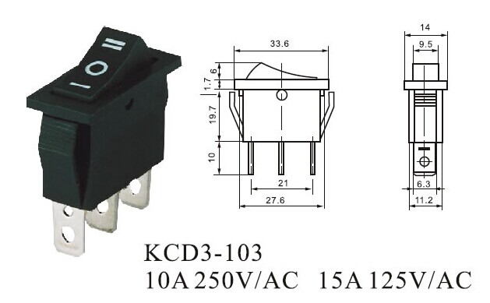
KCD3-103 rocker switch Specification
-KCD3-103 rocker switch
- comes with three settings
-Max voltage: 250V
-Max current: 5A
- can be used in our future product
Notes:
Todo: put voltage imits, current limits

Slide 6
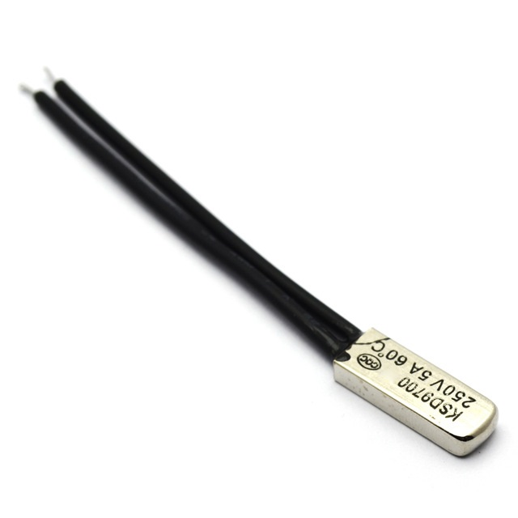
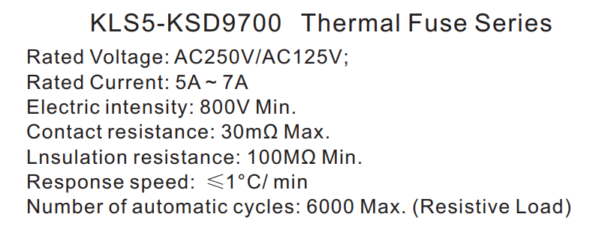
KSD 9700 Thermal cut-off Specification
Interesting things:
-Thermal fuse that will cut off if the temperature of the batteries gets too hot.
- Uses a bimetallic structure to cut off the current
- Cut off temperature and reset temperature is different for different models

Slide 7
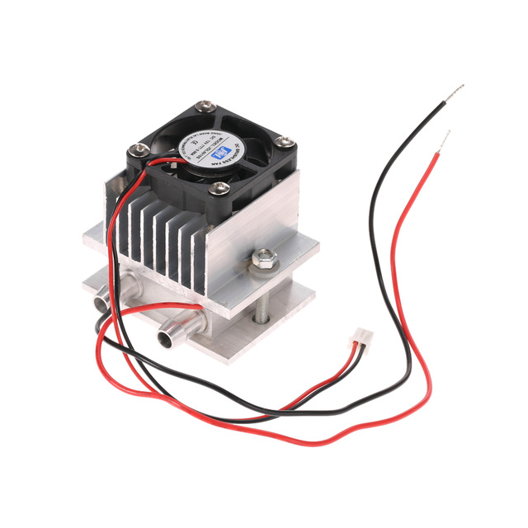
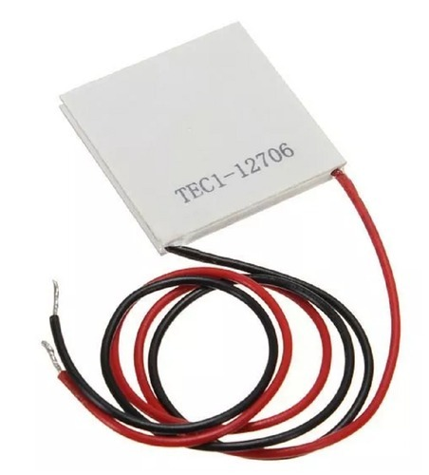
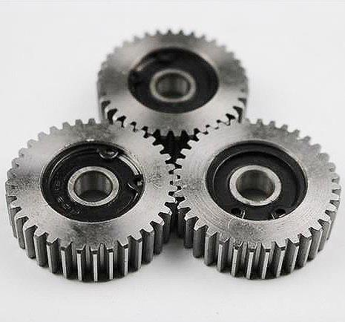
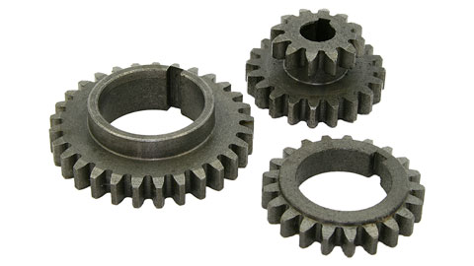
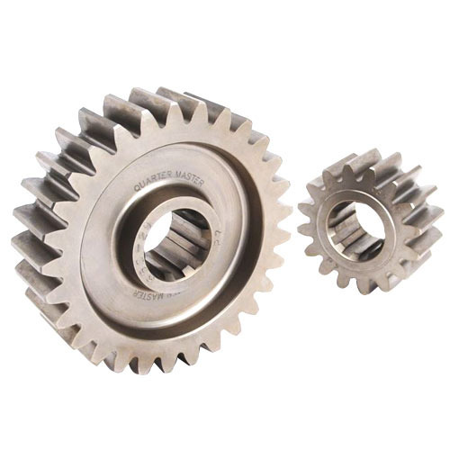
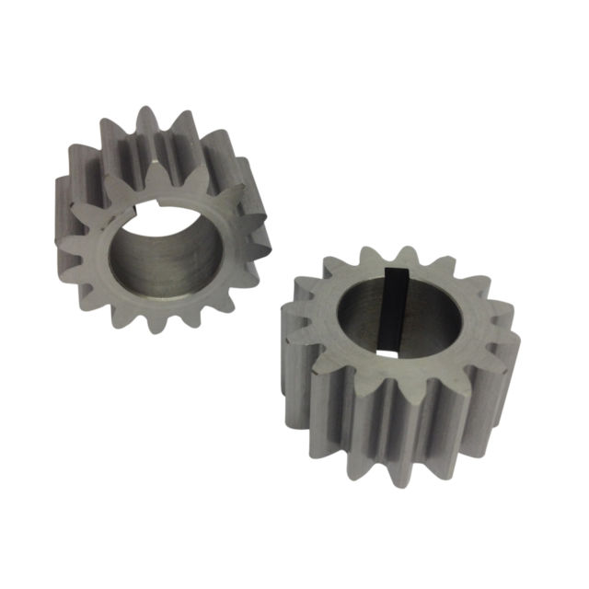
Hardware we can get
We can get a peltier cooler to aid in preservation of samples.
We will requires a mechanical force multiplier that would compress samples taken from nature. That will require steel gears to transfer the power from the motor.

